Slide 1
Captioning images
With DIVERSE Objects

Slide 2

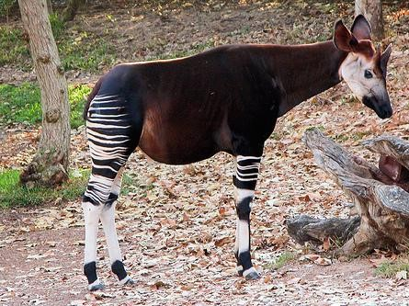


Novel Object Captioner (NOC)
We present Novel Object Captioner which can compose descriptions of 100s of objects in context.
NOC (ours): Describe novel objects without paired image-caption data.
+ ^{MSCOCO} +
Visual Classifiers.
An okapi standing in the middle of a field.
okapi
Existing captioners.
init + train
MSCOCO
A horse standing in the dirt.
‹#›

Slide 3
Insights
1. Need to recognize and describe objects outside of image-caption datasets.
okapi
‹#›

Slide 4
Insight 1: Train effectively on external sources
Image-Specific Loss
Text-Specific Loss
Visual features from unpaired image data
Embed
Embed
Language model from unannotated text data
LSTM
CNN
‹#›

Slide 5
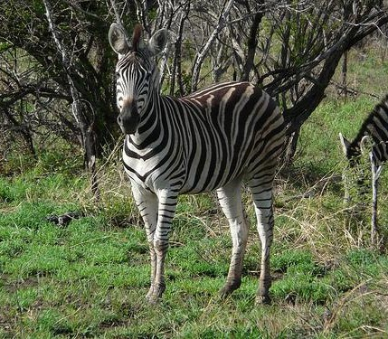
Insights
2. Describe unseen objects that are similar to objects seen in image-caption datasets.
okapi
zebra
‹#›

Slide 6
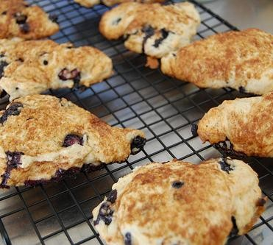
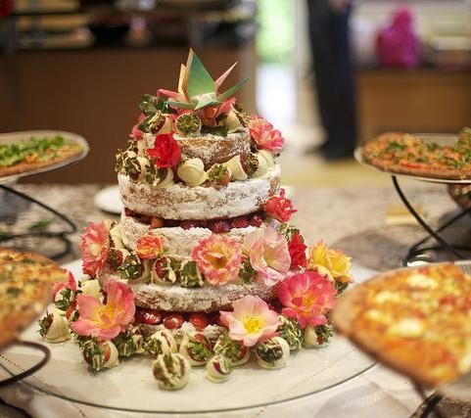
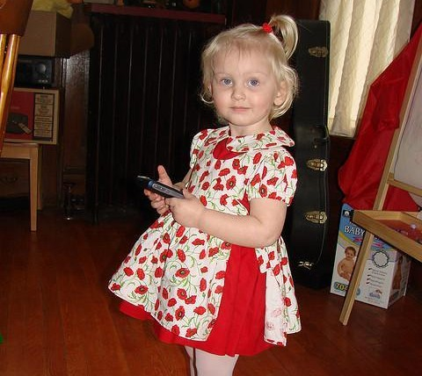
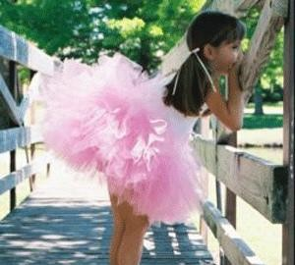
Insight 2: Capture semantic similarity of words
scone
^{Image-Specific Loss} Text-Specific Loss
zebra
Embed
W^{T}glove
cake
Embed
LSTM
CNN
okapi
tutu
Wglove
dress
‹#›

Slide 7
Insight 2: Capture semantic similarity of words
scone
^{Image-Specific Loss} Text-Specific Loss
zebra
Embed
W^{T}glove
cake
Embed
LSTM
CNN
okapi
tutu
Wglove
dress
MSCOCO
‹#›

Slide 8

Combine to form a Caption Model
Image-Specific Loss
Embed
CNN
Image-Text Loss
Text-Specific Loss
W^{T}glove
Embed
LSTM
Wglove
Elementwise sum
Embed
W^{T}glove
Embed
init
LSTM
init
parameters
CNN
parameters
Wglove
MSCOCO
Not different from existing caption models. Problem: Forgetting
10

Slide 9
Insights
3. We need to Overcome this “forgetting” since pre-training alone is not sufficient.
[Catastrophic Forgetting in Neural Networks. Kirkpatrick et al. PNAS 2017]
Catastrophic forgetting occurs because when many of the weights where "knowledge is stored" are changed, it is unlikely for prior knowledge to be kept intact.

Slide 10
Insight 3: Jointly train on multiple sources
Image-Specific Loss
Image-Text Loss
Text-Specific Loss
Elementwise sum
Embed
Embed
W^{T}glove
W^{T}glove
joint training
Embed
joint training
Embed
shared parameters
LSTM
shared parameters
LSTM
CNN
CNN
Wglove
Wglove
MSCOCO

Slide 11
Novel Object Captioner (NOC) Model
Joint-Objective Loss
Image-Specific Loss Image-Text Loss
Text-Specific Loss
Element Wise sum
Embed
Embed
W^{T}glove
W^{T}glove
joint training
Embed
joint training
Embed
shared parameters
LSTM
shared parameters
LSTM
CNN
CNN
Wglove
Wglove
MSCOCO

Slide 12
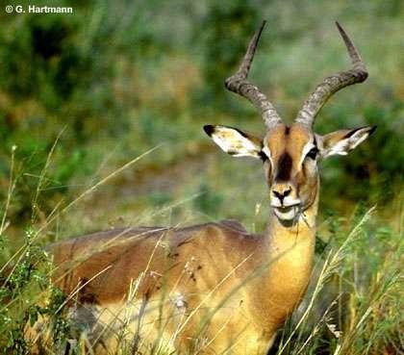
Visual Network
impala:0.86 green: 0.72
...
cut: 0.04
Network: VGG-16 with multi-label loss [sigmoid cross-entropy loss]
Image-Specific Loss
Embed
Training Data: Unpaired image data
Output: Vector with activations corresponding to scores for words in the vocabulary.
CNN

Slide 13
Language Model
Network: Single LSTM layer. Predict next word wt+1 given previous words w0..t
p(wt+1 | w0..t); (Wglove)^{T} : Shared weights with input embedding.
Text-Specific Loss
W^{T}glove
Training Data: Unannotated text data (BNC, ukWac, Wikipedia, Gigaword)
Embed
LSTM
Output: Vector with activations corresponding to scores for words in the vocabulary.
Wglove

Slide 14
Caption Network
Network: Combine output of the visual and text networks. (softmax + cross-entropy loss)
Image-Text Loss
Element Wise sum
Embed
W^{T}glove
Embed
LSTM
CNN
Wglove
MSCOCO

Slide 15
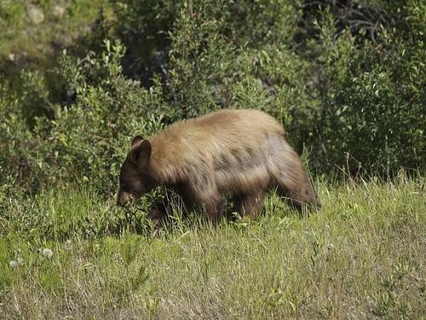
Caption Model
Training Data: COCO images with multiple labels
Image-Text Loss
Training Data: Captions from COCO
Elementwise sum
Embed
W^{T}glove
A brown bear walking on a grassy field next to trees
Embed
LSTM
bear, brown, field, grassy, trees,
CNN
Wglove
walking
MSCOCO

Slide 16
NOC Model: Train simultaneously
Joint-Objective Loss
Image-Specific Loss Image-Text Loss
Text-Specific Loss
Element Wise sum
Embed
Embed
W^{T}glove
W^{T}glove
joint training
Embed
joint training
Embed
shared parameters
LSTM
shared parameters
LSTM
CNN
CNN
Wglove
Wglove
MSCOCO

Slide 17
Empirical Evaluation: Metrics
F1 (Utility): Ability to recognize and incorporate new words.
(Is the word/object mentioned in the caption?)
METEOR: Fluency and sentence quality.
24

Slide 18

Empirical Evaluation: Baselines
LRCN [1]: Does not caption novel objects.
DCC [2] : Copies parameters for the novel object from a similar object seen in training. (also not end-to-end)
[1] J. Donahue, L.A. Hendricks, S. Guadarrama, M. Rohrbach, S. Venugopalan, K. Saenko, T. Darrell. CVPR’15
[2] L.A. Hendricks, S. Venugopalan, M. Rohrbach, R. Mooney, K. Saenko, T. Darrell CVPR’16

Slide 19
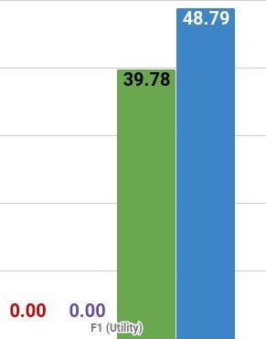
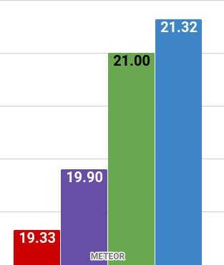
Empirical Evaluation: Results
F1 (Utility)
METEOR (Fluency)
[1] J. Donahue, L.A. Hendricks, S. Guadarrama, M. Rohrbach, S. Venugopalan, K. Saenko, T. Darrell. CVPR’15
[2] L.A. Hendricks, S. Venugopalan, M. Rohrbach, R. Mooney, K. Saenko, T. Darrell CVPR’16

Slide 20


Novel Object Captioner - Take away
Semantic embeddings and joint training to caption 100s of objects.
MSCOCO
A okapi standing in the
middle of a field.

